Slide 1
RAPID PROTOTYPING COLLABORATION
Semester : Fall 2017
Info 7330:Data Solutions for Health Care
Start Date: Tuesday, November 28, 2017
End Date: Tuesday, December 12, 2017
Partners:
Nancy O’Hare
Team 1
Sonali Chaudhari
Gurwinder Mashiana
Praneeth Reddy
Ankur Muley

Slide 2
PROJECT CHARTER
Project Charter
Element | Description | Details
Project Name | Unique identifier for project | Supportive Care Program for Cancer Related Fatigue (SCP)
Problem Statement | Define the current state | Fatigue is one of the chief complaints patients have while undergoing treatment for patients. The health care network have 3 different EMRs and there is no system to integrate data from the EMRs.
Objective | What improvement is targeted? | To design and develop a data driven business intelligence system with decision support, query capabilities and dashboards to aid clinical decision making.
Process Metrics | Baseline metrics and targets so that improvements can be tracked
 | Metric |  | Baseline | Target
 | Fatigue program enrollment |  | N/A | 95%
 | % of UP time |  | N/A | 99%
 | Success Rate of Care delivery Systems |  | N/A | 95%
 | No of facilities covered under the program |  | N/A | 100%
 | Hiring of necessary professionals for SCP |  | N/A | 5
 | Device Accuracy Testing |  | N/A | On every visit
Notes: % Up time is for patient web portal, device used by patients and provider.
Team Members: Sonali Chaudhari, Gurwinder Mashiana, Praneeth Reddy, Ankur Muley
Project Start Date: 3 December 2017

Slide 3
CRITICAL TO QUALITY
Goals | Drivers | Critical to Success
Consistent and Centralized database | Sharing of information, combining data from all 3 EMRs | Standardization of database, consistency data
Maintaining privacy of patients | Securing patients data | Authorized access, database security
Maintenance of provided wearable device | Accurate data generation, Tracking of fatigue | Accuracy of data gathered from the device,
Program Effectiveness | Reducing fatigue in cancer patients | Accurate information from patients, Tracking of patients’ medical history

Slide 4
Failure Modes and Effects Analysis
 | Failure | Root Cause | Severity (Rate 1-10, 10= Most Severe) | Probability of occurrence (Rate 1-10, 10= Highest Probability) | Probability of detection (Rate 1-10, 10= Lowest Probability) | Risk Preference Number(RPN)
 |  |  | A | B | C | AxBxC
1 | System crash/server failure | Network Failure | 9 | 5 | 2 | 90
2 | Loss of Data/Duplicate Data/ Data inconsistency | Corrupt database | 9 | 5 | 3 | 135
3 | Security Breach | Unauthorized access/Hacking | 10 | 3 | 8 | 240
4 | Report generation issue | Device failure/ Malfunction | 5 | 4 | 5 | 100
5 | Lack of patient participation | Patient ignorance, lack of awareness | 7 | 5 | 5 | 175

Slide 5
BUSINESS MODEL
Key Partners Hospitals Laboratories Medical Supply Companies Insurance Companies Government Organization Funding Organization Providers | Key Excellent Customer Service R&D to prevent, treat, and cure diseases Clinical Development Educating Patients | Value Proposition Best care to every patient everyday through integrated clinical practice, education and research Be a dependable source of health information for our patients and public. E-services Conduct basic and clinical research program. Educate physicians and allied health professionals. | Customer Relationships Conference calls and interactive learning sessions Website Outreach teams Courtesy calls Customer data handling | Customer Segments Adults Children Senior Citizens Veterans
 | Key Resources Clinical IT Staff Platform (EMR) Data System Licenses, Patents, and Industrial Properties Researchers Investors |  | Channels Medical Institution (hosp-itals, pharmacists, health personnels) Media commercials Social media Website Newspaper Ads Followup emails Word of Mouth
Cost Structure R&D Partnerships and Acquisitions Equipment Employees Maintenance of e-services Marketing Utilities Communication and publicity |  | Revenue Streams Billing Billing for e-services Wearable devices Insurance Payment Plans Registration Costs

Slide 6
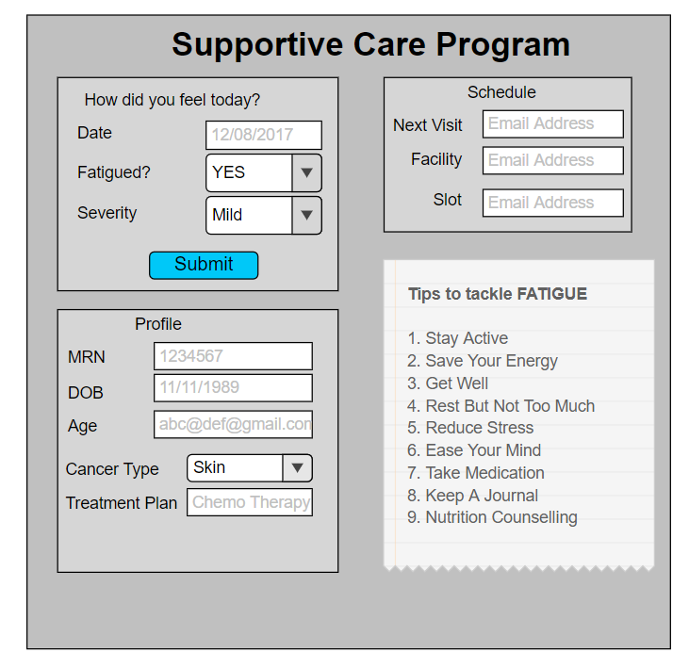
Consolidated Database
Provider Portal
Data Visualization
Search Functionality
Export
Queries on Data
Patient Portal
Customized Dashboards
Data Visualization
Export
Data Analysis
Smart Phone App
Wearable devices
Fatigue Fighting Program
SOLUTION

Slide 7
SCP is an inter-professional committee to develop an interactive, psychoeducational class for cancer patients
The focus is multidimensional ,supported with current evidence-based guidelines on fatigue
Developed with expertise from the fields of social work, Neuropsychology, Nutrition, Physiotherapy.
Session will be professionally facilitated by members of the SCP.
Registration will be required
Services
Psychosocial
Nutrition
Physiotherapy services
Group Sessions
2 sessions per week free for 12 weeks
Paid sessions after 12 weeks
Paid Individual Sessions
Personalized plan.
Initial feedback via formal evaluation after sessions
Sessions will be offered by telemedicine too
SUPPORTIVE CARE PROGRAM(SCP)

Slide 8
To pilot test this program for a community
In future research, patient-reported outcomes for the management of CRF will be tracked
Programs could be cosponsored by several collaborating institutions to share resources
Future Scope of SCP

Slide 9
Clinicians will be able to open and access the dashboards created to make informed systems about the fatigue plans for different patients.
Based on different security levels(Physician, Surgeon, RNs, Medical Assistant), information is accessible to the healthcare provider.
This is a form of EMR that facilitates the interoperability and the use of technology such as Tableau allows interactive graphs that can shared with multiple stakeholders.
Static and Dynamic reports can exported and made available at a click of a button.
Patient-reported outcomes are collected to measure CRF(Cancer Reported Fatigue)
Future goals of this project is to expand this project to whole community with help of other institutions.
Conclusion

Slide 10
THANK YOU!

